Slide 1


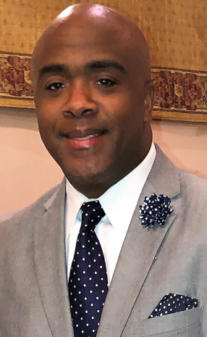
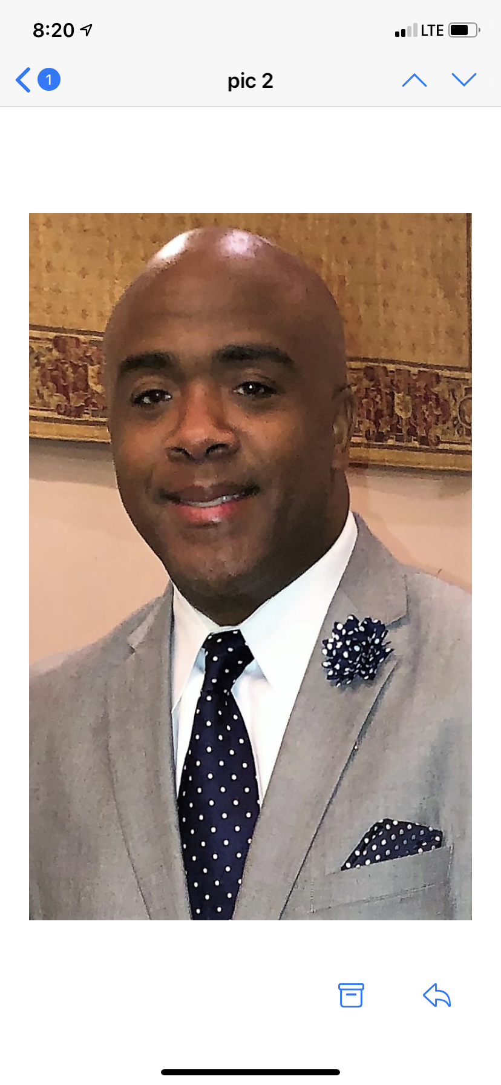

Congratulations and welcome to Fulton County Government!
W e are excited to have you join our team. My name is Jeffrey Dinkins, Sr. and I will serve as your New Employee Orientation Facilitator.
If you need any assistance, please contact me via email: jeffrey.dinkins@fultoncountyga.gov

