Slide 1
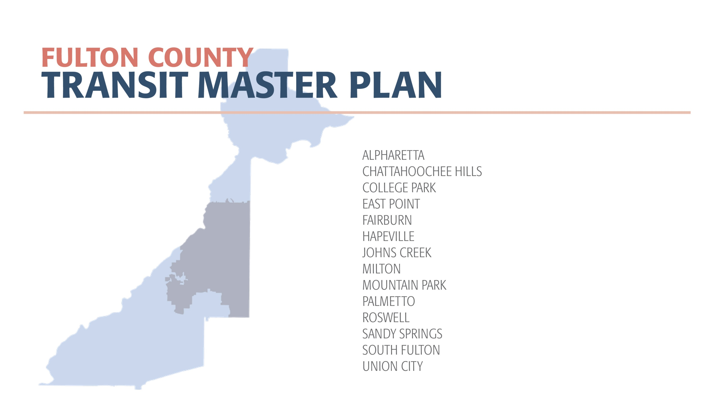

June 2019
Short-Term Plan
Update

Slide 2
Executive Summary
This presentation outlines an update to Fulton County’s Transit Master Plan:
The proposed short-term plan update includes $1.6 B in rapid transit projects across Fulton County, based on the passage of HB 930 (which allows for a 0.2-cent sales tax over 30 years), $100 M in State funding allocated to GA 400, and an assumed $200 M in Federal funding.
The updated project list has been discussed with Mayors across the County to address and largely resolve issues related to equity.
In those discussions, several strategic concerns were raised related to economic development potential (along South Fulton Parkway and the Aerotropolis area), potential ridership and traffic impact (along GA 400), and alternatives to SPLOST-type funding for transit.
More consistent dialogue with the Mayors will be needed as we move forward.
2

Slide 3
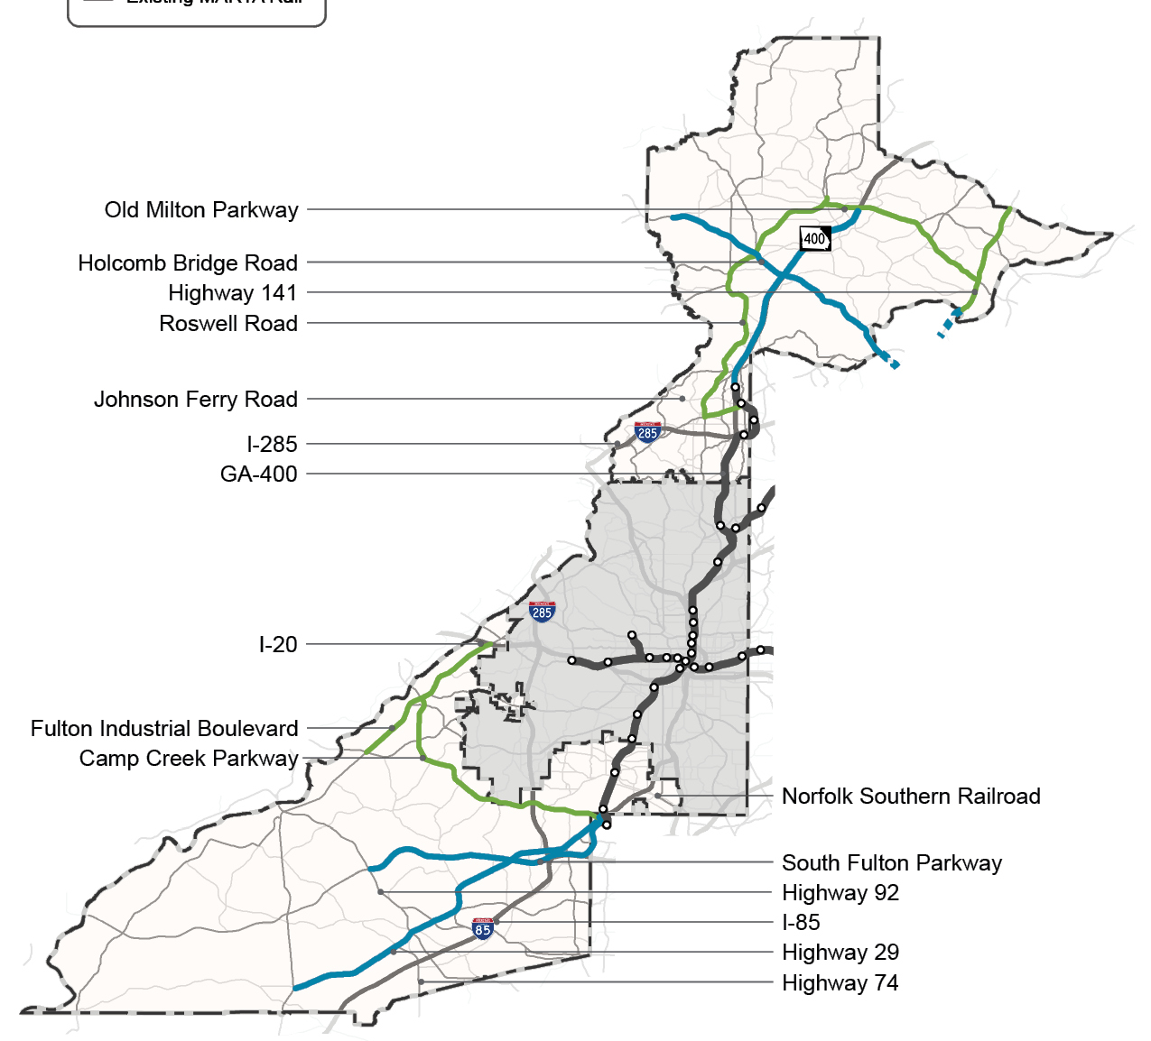
January 2018 Adopted Short-Term Plan
Rapid Transit- Dedicated/Express Lanes
GA 400
South Fulton Parkway
Holcomb Bridge Road/Highway 92
Highway 29/Roosevelt Highway
Rapid Transit- Shared Lanes
Roswell Road/SR 9
Old Milton/State Bridge
Fulton Industrial Boulevard
Camp Creek Parkway
Highway 141
Other
Southside Park and Ride
Last Mile/Bus Shelters/Station Connectivity
Micro-transit Service Areas
3

Slide 4
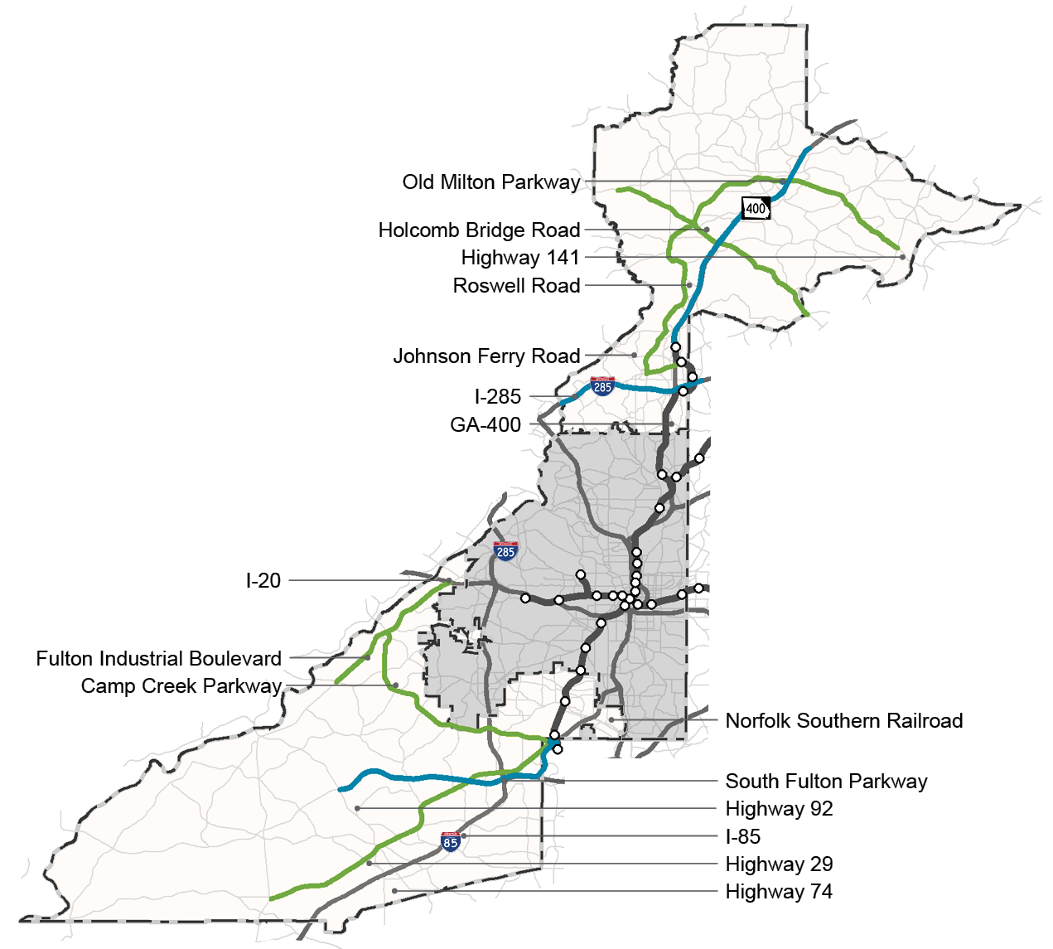
2019 Short-Term Plan Update
Rapid Transit- Dedicated/Express Lanes
GA 400
South Fulton Parkway
I-285 Top End
Rapid Transit- Shared Lanes
Holcomb Bridge Road/Highway 92
Highway 29/Roosevelt Highway
Roswell Road/SR 9
Old Milton/State Bridge
Fulton Industrial Boulevard
Camp Creek Parkway
Other
Southside Park and Ride
Last Mile/Bus Shelters/Station Connectivity
4

Slide 5
Funding Assumptions
Corridor | Right of Way | Fulton Transit Plan following HB 930 (0.20% Sales Tax) | Fulton Transit Plan May 2019 Update (0.20% Sales Tax) | Potential for Other Funding Assistance May 2019 Update
GA 400 | Express
South Fulton Parkway | Dedicated
I-285 | Express
Holcomb Bridge Road | Shared
Roosevelt Highway | Shared
Old Milton/State Bridge | Shared
Fulton Industrial/Camp Creek | Shared
Southside Park and Ride | Other
Last Mile, Bus Shelters, Stations | Other
5

Slide 6
Funding Assumptions
Corridor | Right of Way | Fulton Transit Plan following HB 930 (0.20% Sales Tax) | Fulton Transit Plan May 2019 Update (0.20% Sales Tax) | Potential for Other Funding Assistance May 2019 Update
GA 400 | Express | $335 M | $130 M | $200 M*
South Fulton Parkway | Dedicated | $165 M | $70 M | $75 M*
I-285 | Express | N/A | $285 M | $ - M*
Holcomb Bridge Road | Shared | $135 M | $130 M | $ 5 M*
Roosevelt Highway | Shared | $280 M | $270 M | $10 M*
Old Milton/State Bridge | Shared | $115 M | $110 M | $ 5 M*
Fulton Industrial/Camp Creek | Shared | $150 M | $145 M | $ 5 M*
Vehicle Purchases/Replacement | Other | $69 M | $69 M
Southside Park and Ride | Other | $ 1 M | $ 1 M
Last Mile, Bus Shelters, Stations | Other | $90 M | $90 M
* Other funding assistance potential based on discussions with MARTA with a goal of $300 M total outside funding.
6

Slide 7
Implementation Timeline
Based on funding model and coordination with other improvement projects.
IMMEDIATE | TIMEFRAME 1 (~5 years) | TIMEFRAME 2 (5-10 Years)
Last Mile/Bus Shelters/ Station Connectivity | Highway 29/Roosevelt Highway | I-285 Top End
Southside Park and Ride | South Fulton Parkway | Holcomb Bridge/Highway 92
 | GA 400 | Fulton Industrial/Camp Creek
 |  | Old Milton/State Bridge
7

Slide 8
Next Steps from May 3, 2019 Commission and Mayors Meeting
Adopt the updated Short-Term Transit Plan with project list as presented.
Pursue alternate funding strategies in addition to a Sales Tax Referendum including state-level strategic investments.
Complete additional analysis for projects in the short-term update, including ridership projections for GA 400 and economic development potential along South Fulton Parkway.
Finalize preliminary design and station locations for rapid transit projects in dedicated or managed lanes (GA 400, South Fulton Parkway, I-285)
Plan voter education process.
Make go/no-go decision on Nov. 2020 Call for Referendum.
9

