Slide 1

Fulton County Dept of Information Technology

Slide 2

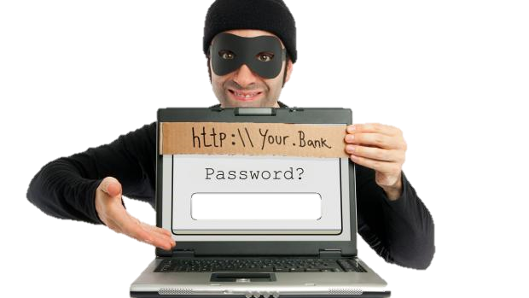
Criminals are increasingly using email to target users
or trick users into doing something against his/her best interest.
Notes:
Why do we talk about cyber security

Slide 3
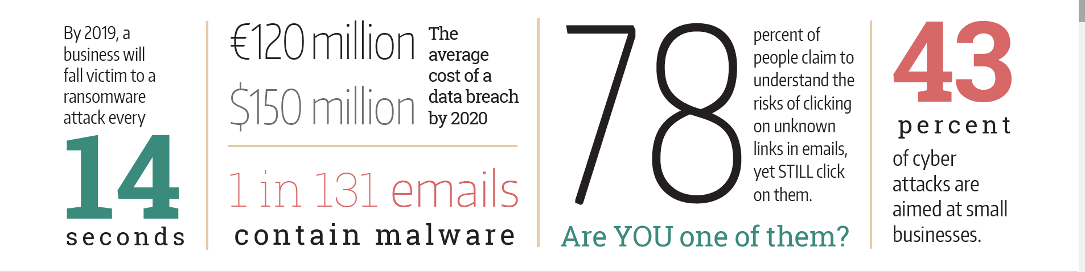

Slide 4


more than …
90%
of people who receive phishing emails which contain a link for FREE COFFEE fall victim to the scam
Notes:
More over if that cup of coffee is FREE – why is information like your credit card, employee ID, password and place of employment required?
Our goal is to help our users identify phishing …

Slide 5
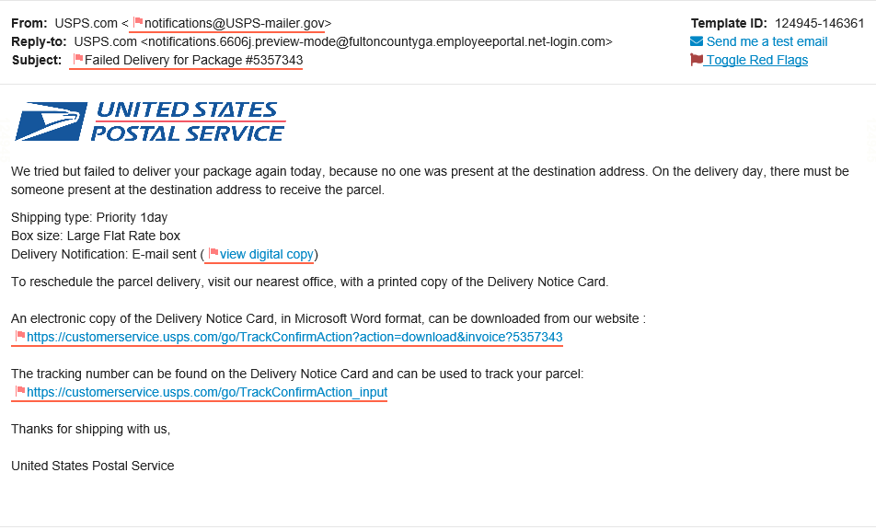
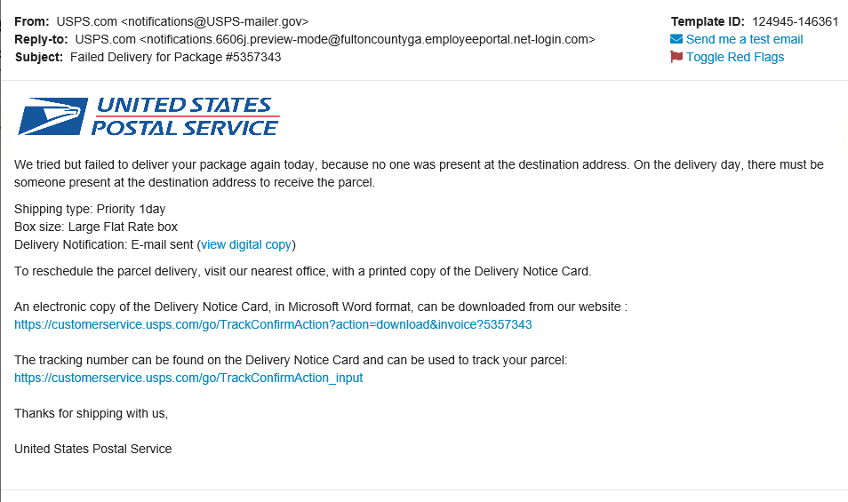

Slide 6

Fulton County IT, Human Resources and Finance (Payroll) will never request employees to provide sensitive or confidential information such bank account information or social security number via email, or text message.

Slide 7

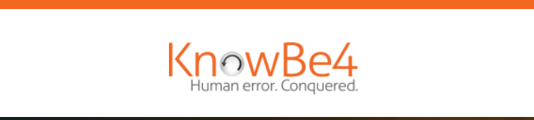
Awareness Training Program
+
Notes:
Little bit of information today Security Training & Awareness will be ongoing…. In August we will launch security awareness training mandatory – but online and just 30 minutes of your time.

Slide 8
Questions
Nicole Keaton Hart
Chief Information Officer (CIO)
Department of Information Technology
Fulton County, GA
o 404.612.0057
e nicole.keaton-hart@fultoncountyga.gov

