Slide 1
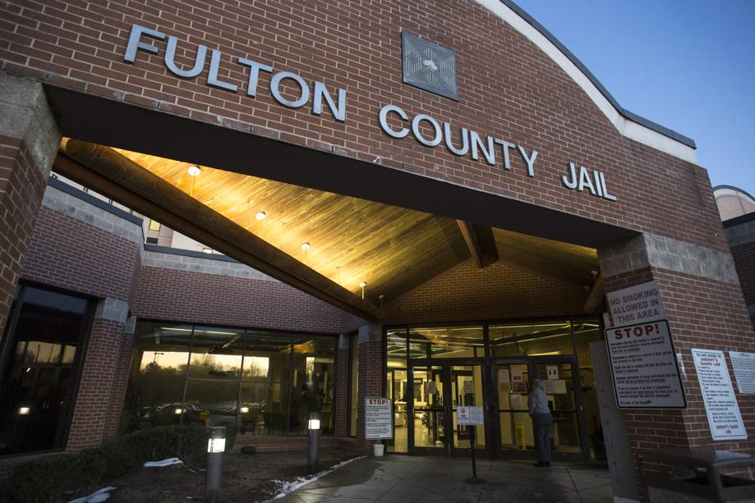

Fulton County Replacement Jail Capital Improvement Program
Procurement Information session
November 8, 2023

Slide 2

agenda
Current state of the jail
General information for the replacement jail
Upcoming procurements
Anticipated project schedule
Purchasing requirements
Doing business with Fulton County

Slide 3
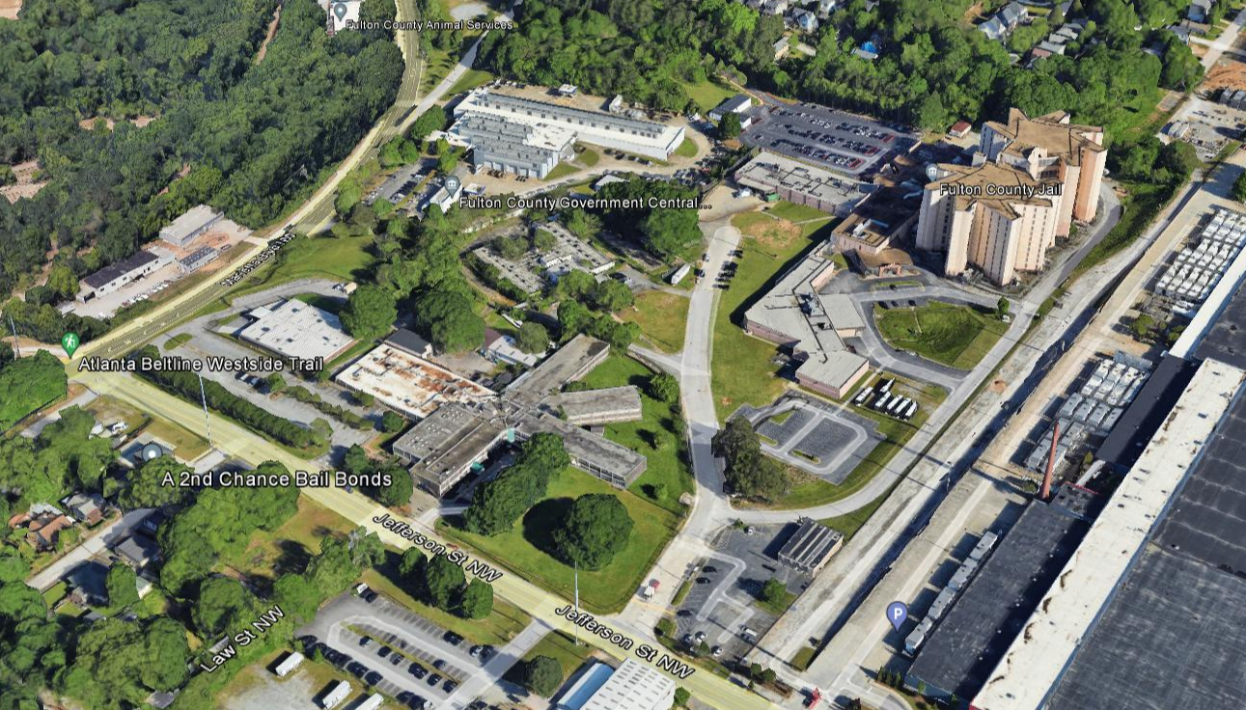
Current State of the Jail
The inmate population at the Fulton County Jail is beyond capacity and has created significant safety issues for detention officers and detainees
Problems are exacerbated by severe shortages in detention officers and deteriorating physical conditions within the facility
Outsourcing agreements are in place with the City of Atlanta and counties across the state and ongoing maintenance is being conducted, but these measures only provide short-term relief
For a long-term solution, Fulton County has commissioned a feasibility study to answer the following key questions:
  Does Fulton County need a replacement jail?
  How big should it be?
  What services should it provided?
  Where should it be located?
  How much will it cost?

Slide 4
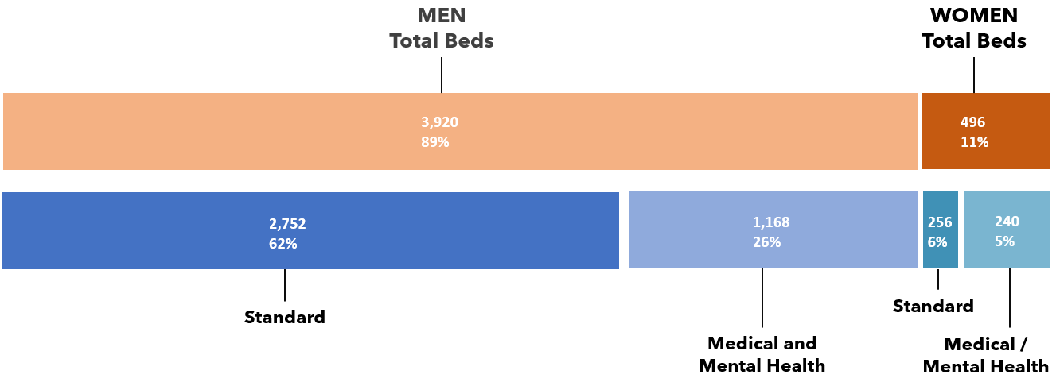
General information for the replacement jail
The County is planning for the design, construction and ongoing maintenance of a replacement jail at the approximate program cost of $1.685 billion
Our vision is to deliver a facility that provides a safe, humane, and sustainable environment reflecting best practices in pretrial detention
The new facility is anticipated to be 1.7 million GSF containing 4,416 beds

Slide 5
General information for the replacement jail
The scope of the overall program includes:
  All activities and vendors supporting the financing, planning, design and construction of a replacement jail facility within the $1.685 billion budget
  Additional projects within the program (but not currently in the budget) include:
    Relocation of Accountability Court, Fulton County Central Maintenance, and the homeless shelter at Jefferson Place
    Demolition of the existing Rice Street Jail
Financing and delivery options for the replacement jail are currently being evaluated
  Potential financing options: GO bond, third-party conduit issuance, public-private partnership (P3)
  Potential delivery methods: Design Build (DB), Design Build Finance Maintain (DBFM), Construction Manager at Risk (CM@R)
Interested vendors for all program services will need to demonstrate experience with all financing and delivery options, until final decisions are made by the County

Slide 6
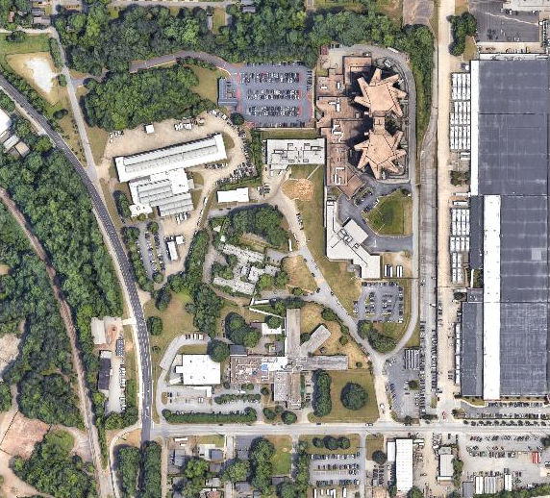
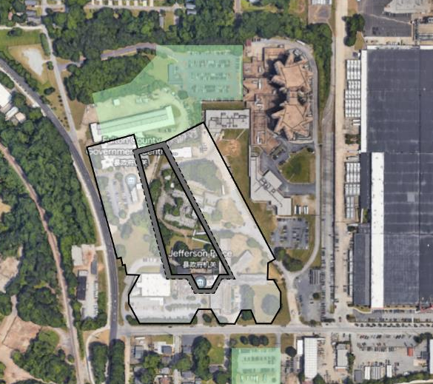
General information for the replacement jail
The replacement jail is expected to be built at the existing Rice Street campus with relocations of County programs noted below
Staff Parking
Staff Parking
Fulton County Jail
Vehicle Maintenance
Potential Footprint of Replacement Jail
Accountability Court
Jefferson Place
Public Parking

Slide 7
Upcoming Procurements – Anticipated Schedule
The County anticipates a phased approach to procure program vendors
All procurements will be open and competitive, and the County anticipates taking a two-step approach (issuance of an RFQ followed by RFP) unless otherwise stated
*The procurement structure and timing of the design and construction team(s) will be determined once the final decisions are made on the financing and delivery of the program
Phase | Service | Expected to Market
Phase I | Program Management Team | Q4 2023
Phase I | Financial Transaction Advisor | Q4 2023
Phase I | Legal Counsel | Q1 2024
Phase I | Bond Counsel | Q1 2024
Phase I | Site / Environmental Investigation | Q1 2024
Phase II | Development Team or Design Team* | Q1 2024
Phase II | Construction Team* | Q2 / Q3 2024*
Phase III | Systems Commissioning | Q1 2027
Phase III | Furniture, Fixtures & Equipment | Q2 2028

Slide 8
Upcoming Procurements – Program Management Team
Procurement of the Program Management Team is a top priority for the County
The Program Manager must demonstrate the expertise, ability, and related experience to lead the overall delivery of a multi billion dollar detention/correctional facility
The Program Manger will serve as the County’s representative, advising on all project related matters across all phases of the program
The scope of the Program Manager is anticipated to include:
  Advising the County on the optimal financing and delivery methods for the program
  Assisting with drafting procurement documents, especially the design/construction components of the project
  Managing and independently reporting on the scope, schedule, budget, and risks of all County vendors on the project, and for the overall program
  Chairing meetings as needed, preparing materials, taking and sending minutes, and other administrative responsibilities
  Developing communications strategies and materials to engage program stakeholders including the County executive team, Board of Commissioners, Sheriff’s Office, general public, market participants, and others

Slide 9
Anticipated project Schedule
The project schedule is high-level currently and will be refined once the financing and delivery methods of the program have been finalized
Project Phase | Timeline
Programming & Planning Phase | 2022 – 2024
Design Phase | 2024 – 2026
Construction Phase | 2026 – 2028
Commissioning & Closeout Phase | 2028
Transition & Occupancy Phase | 2028 – 2029

Slide 10
Purchasing requirements – Project Specific Requirements
Demonstrate experience with construction projects valued $1 billion and above
This project is valued over $5,000,000.00 and will require a joint venture relationship
If the joint venture relationship inclusive of an MBE or FBE firm, the MBE or FBE member(s) of the joint venture must be certified as such by the Office of Contract Compliance
A written joint venture agreement, completed by all parties of the joint venture, executed before a notary public, that clearing delineates the rights and responsibilities of each member or partner will be required

Slide 11
Purchasing requirements – Certification
Certification is granted to businesses 51% owned, operated, and controlled by a Minority Business Enterprise (MBE), Female Business Enterprise (FBE), Small Business Enterprise (SBE), Disadvantage Business Enterprise (DBE) or Service-Disabled Veteran Business Enterprise (SDVBE)
The County accepts certification from the following agencies that streamlines the County’s application process:
  FBE firms certified by the Women Business Enterprise National Council (WBENC) and the City of Atlanta
  MBE firms certified by the Georgia Minority Supplier Development Council (GMSDC), and the City of Atlanta
  SBE firms certified by the Small Business Administration and the City of Atlanta, GDOT and MARTA
All certification applications are available online using the B2GNOW software program
The application for all certifications can be located online at https://fultoncountyga.diversitycompliance.com/
For more information contact the Office of Contract Compliance at (404) 612-6300

Slide 12
Purchasing requirements – Prohibition on Future Procurements
Prime Contractor
The Prime Contractor selected to provide services to the County (including Program Management Services) and any team members of the Joint Venture shall not be eligible to perform any other services, including but not limited to; design services, construction and construction management, or any advisory services under the Program, during the term of the Contract and any extension(s) thereof
Subcontractor / Consultant
If you are a subcontractor / consultant to the selected Prime Contractor providing services to the County (including Program Management Services), your firm shall not be eligible to perform design or advisory services under any circumstances where a conflict exists or may potentially exist. A conflict shall be defined as a review function of any work performed under the oversight of the Program Management Team
Employee
Employees of the Prime Contractor or Subcontractor / Consultant are advised to avoid conflicts
Full disclosure of their involvement in the Project shall be made, should they decide to propose on projects independently in the Program

Slide 13
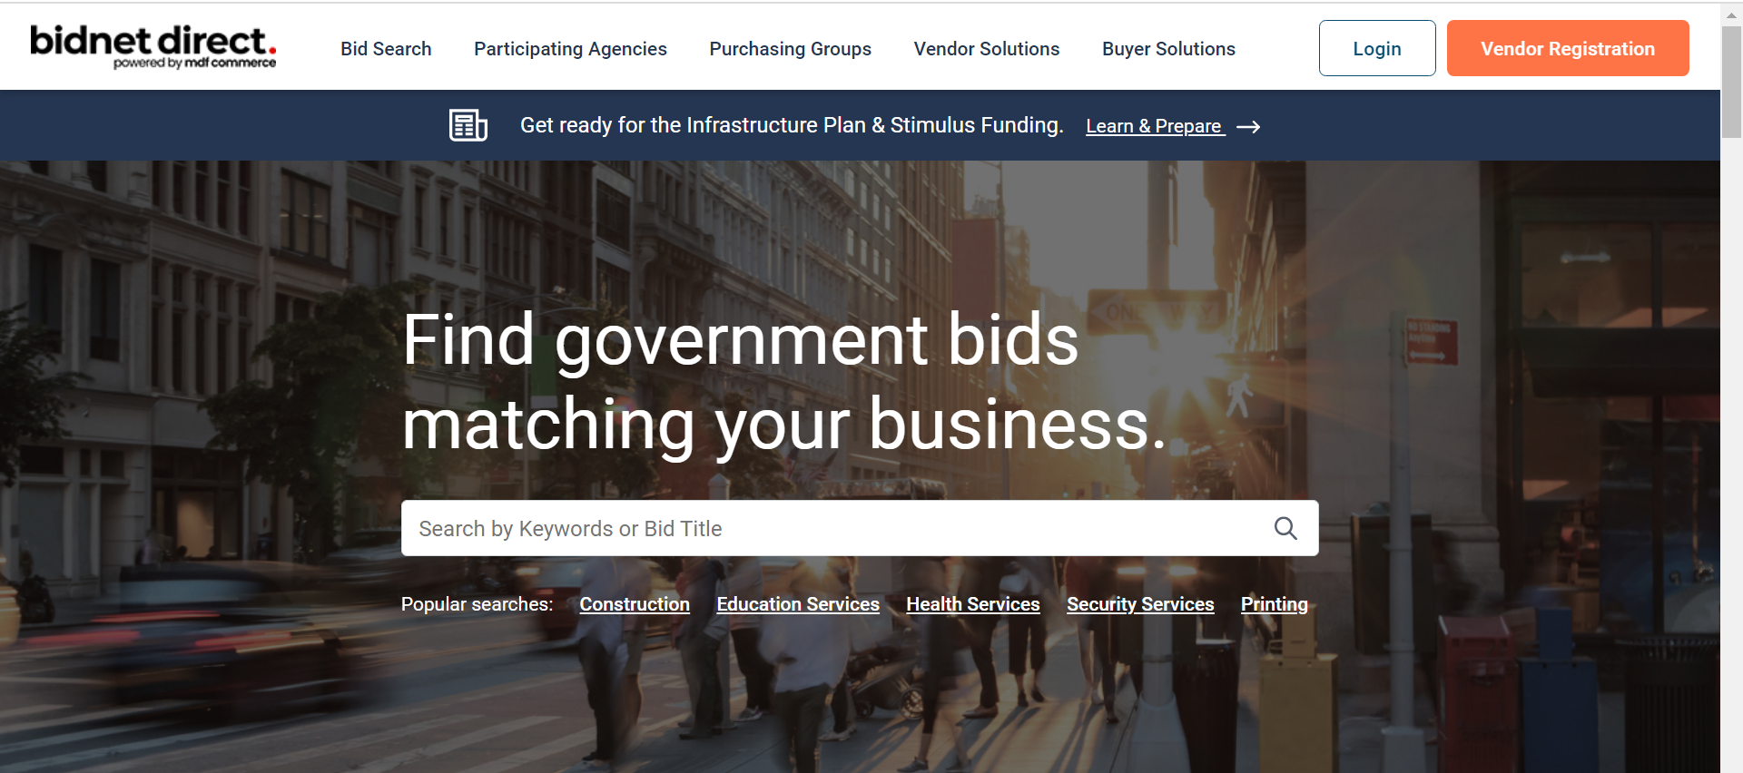
Doing Business with Fulton County – Get Registered
The County uses an E-Procurement platform (BidNet Direct) to advertise the County’s bid opportunities
Your firm will need to register with BidNet to download the solicitation, view addenda, and upload responses to the solicitation
Registration is free to review Fulton County’s bid opportunities. In the address bar type https://www.bidnetdirect.com/

Slide 14
Doing Business with Fulton County – Vendor Self-Service System (VSS)
If your firm is successful, your firm must be registered in the County’s AMS System in order for the Department of Purchasing & Contract Compliance to issue your company a Purchase Order or to receive payments
  To register go to https://vss.fultoncountyga.gov/webapp/VSSPROD/AltSelfService
  You must provide a copy of your current Business License and a W-9 to complete the vendor registration process
The County pays vendors via Electronic Funds Transfer (EFT)
  The EFT payment method speeds payment delivery by depositing payments directly into your business financial institution and eliminates the possibility of lost or stolen checks, stop payment and check reissue costs

